Slide 1


Data Science vs. Data Analytics
Anish Mahapatra | 17 Oct, 2022

Slide 2

Agenda
01
Introduction
02
What is Data Science?
03
What is Data Analytics?
04
Why choose Data Science or Data Analytics?
05
Tools & Technologies, Job strategies and CTC
06
Let’s Talk!

Slide 3











Topic 1 of 6
Introduction: Am I worth your time?
Lead Data Scientist
LinkedIn: www.linkedin.com/in/anishmahapatra Medium: anishmahapatra.medium.com Website: www.anishmahapatra.com
GitHub: www.github.com/anishmahapatra
Q. What is the future of Data Science?
A. Simple, ask a real-world Data Scientist.

Slide 4
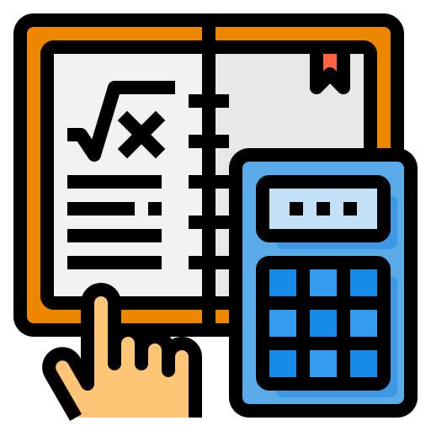


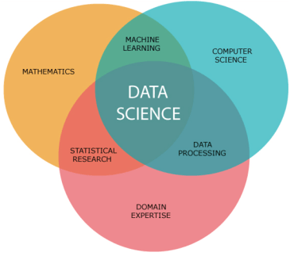
Topic 2 of 6
What is Data Science?
01
02
03
Mathematics
Business
Technology
Understanding the fundamentals of Data Science requires mathematics
Business is the core of every Data Science problem
Evolving technology is what keeps Data Science ahead of every other industry
Notes:
In Industry 3.0, we automate processes using logic processors and information technology. These processes often operate largely without human interference, but there is still a human aspect behind it. Where Industry 4.0 comes in is with the availability and use of vast quantities of data on the production floor.

Slide 5
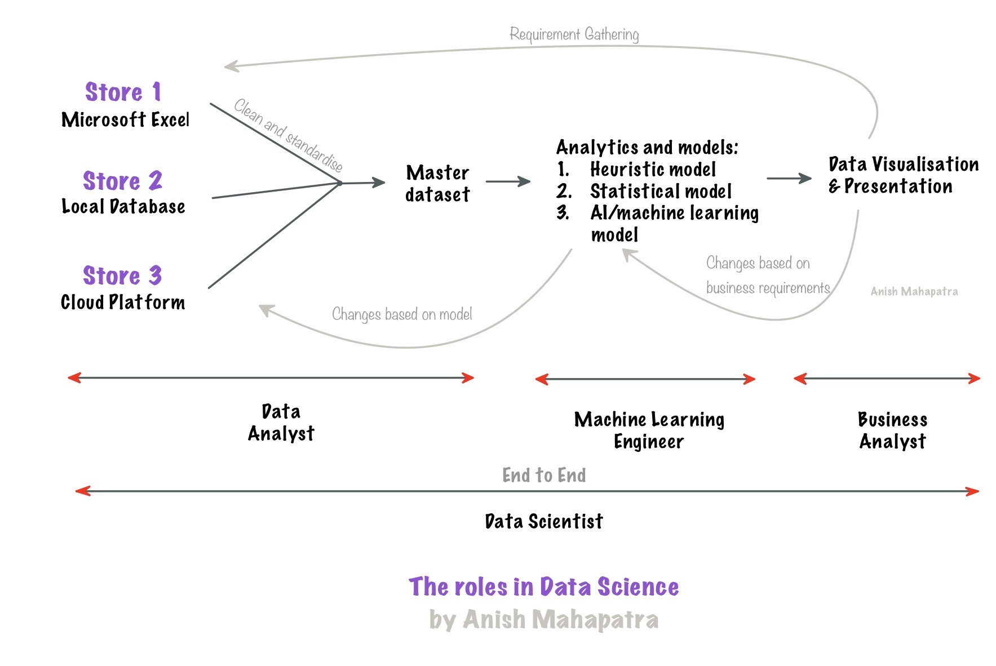
Topic 2 of 6
What is Data Science?

Slide 6



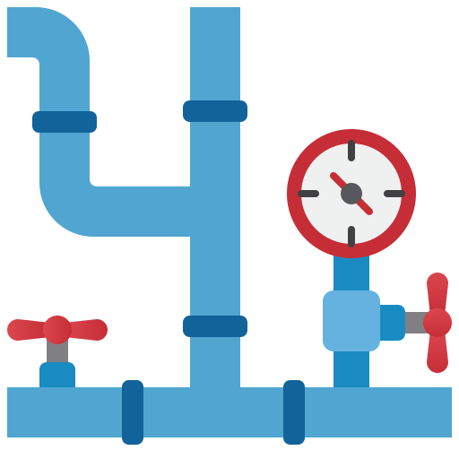


Topic 3 of 6
What is Data Analytics?
Understand the patterns &
structure of data
Deal with the tracking of data
and understand databases
Data Analysts need to understand how the data is stored and structured
Tracking and maintaining large pipelines is an integral part of the Data Analyst’s job
Build pipelines to
enable the flow of data
Track the quality and
governance of data
Data pipelines are an
integral part of data lifecycle
It is important that the right people
have access to the right set of data
Own the Data
In any organization, Data Analyst’s own parts of the data flow, and can add a lot of value

Slide 7
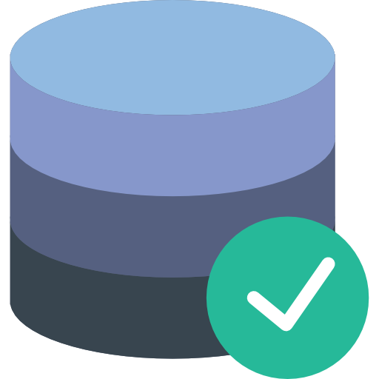
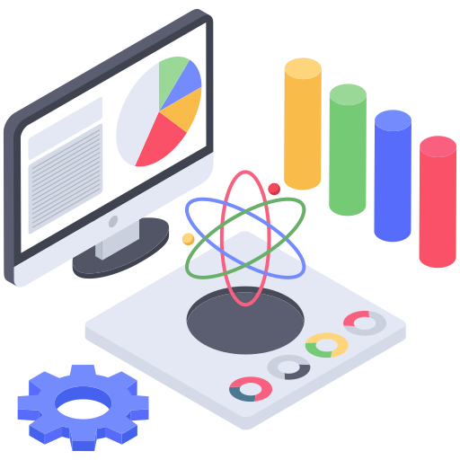



Topic 4 of 6
Why choose Data Science or Data Analytics?
Area of Interest in the Data Field
It is critical to understand yourself and your areas of interest to understand where you belong
Domain Expertise
Based on your previous experience, you can decide which area you would like to go into
Market Supply-Demand
Always follow the market. Understanding the supply and demand curves of the market will help you get the best paying job
Tools & Technologies
Having the right tools and skillset
can help you navigate the right jobs

Slide 8




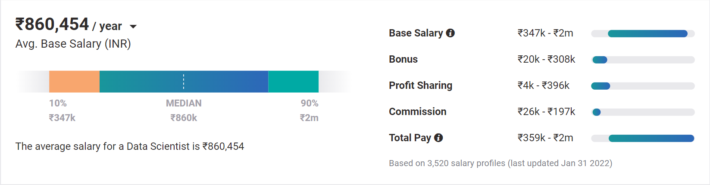
Topic 4 of 6
Why choose Data Science?
01
02
03
Relevance in the future
Business & Technology
Industry-Agnostic
Companies are building and growing in Data and it is the future.
Data Science is a combination of Business, Math and Technology, so growth can be in business / technology
Use your existing knowledge / domain / technology expertise with a data-edge
04
Extremely High Market Demand
Supply-Demand mismatch means companies are willing to pay more
Notes:
Source:https://www.payscale.com/research/IN/Job=Data_Scientist/Salary

Slide 9
Topic 4 of 6
How to leverage a degree to get there?
01
02
03
Set Target
Talk to people
Build LinkedIn Profile
Understand the Data Field,
Understand roles & responsibilities,
Look at a 5-year path
Talk to people who are already doing what you want to do
Add certifications, participate in competitions, do simple projects, look at how the best of the best do it
06
05
04
Build Collaterals & Profile (30%)
Globally Accepted Degree (70%)
Explore Certifications
Multiple certifications don’t help, the quality of it does.
GitHub, LinkedIn,
Medium, Brand Profiling
Globally recognized degree, Degree Accepted by MNCs,
Possibility of PhD later,
Alumni Status
Bonus - WES Certification, Teachers from the industry
Notes:
All we care about is how to get a job, let me tell you how to leverage MSc to get a job!

Slide 10







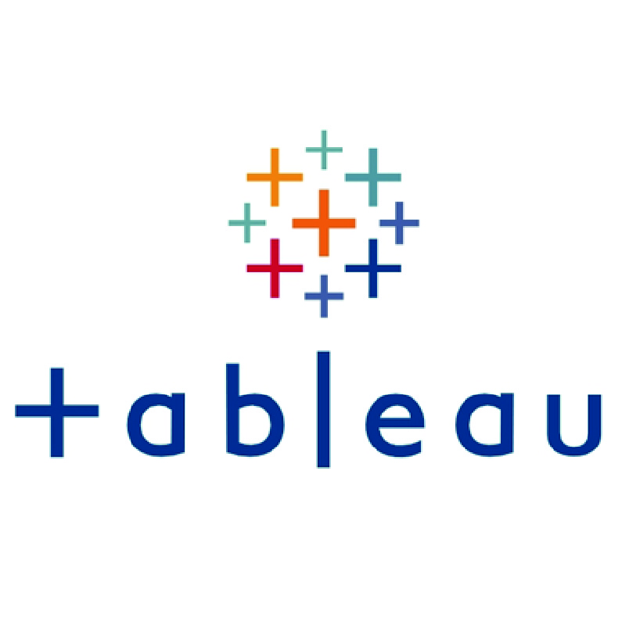
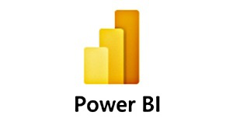







Topic 5 of 6
Tools & Technologies in Data Science
Data Analyst
Machine Learning Engineer
Business Analyst
Data Scientist

Slide 11






Topic 5 of 6
Resume Optimization

Slide 12
Key Takeaways
01
Introduction
02
What is Data Science?
03
What is Data Analytics?
04
Why choose Data Science or Data Analytics?
05
Tools & Technologies, Job strategies and CTC
06
Let’s Talk!

Slide 13

Data Science vs. Data Analytics
Anish Mahapatra
Let’s Talk!
LinkedIn: www.linkedin.com/in/anishmahapatra
Email: anishmahapatra01@gmail.com

